Slide 1
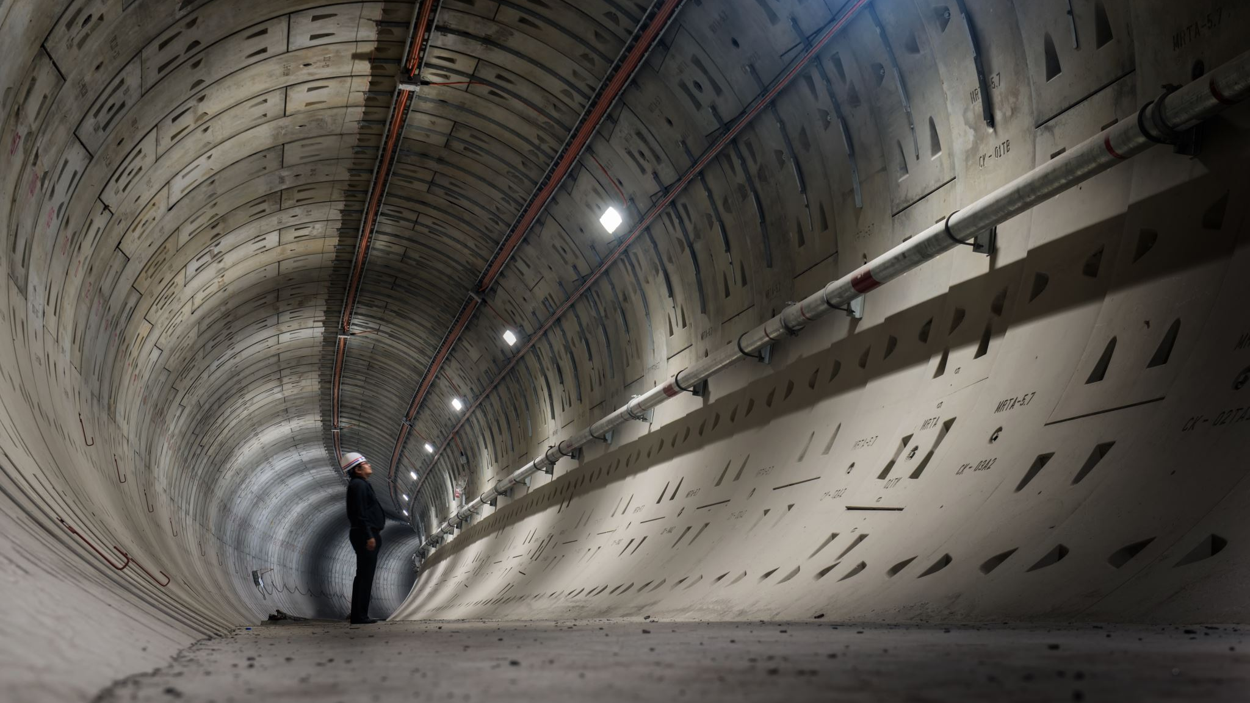
Enhancing Accident Investigation using Traffic CCTV Footage
-
Akshara Priya Peddi
007775008

Slide 2

INTRODUCTION AND BACKGROUND
Understanding Traffic Accidents
Insurance Importance
Accident Severity Analysis
Intelligent Traffic Surveillance Systems
System's Value
Current Surveillance Methods

Slide 3

RESEARCH QUESTION
What is the impact of usage of augmentation techniques on imbalanced datasets?
How will the hyper parameter tuning affect the model performance?
How the proposed model is effective compared to existing work?

Slide 4
What is the impact of usage of augmentation techniques on imbalanced datasets?
Reference to the paper by Veni et al. (2021).
Emphasis on the limitations of existing techniques and the need for accurate and cost-effective methods.
The Faster R-CNN algorithm for precise accident detection using deep learning.
Testing and accuracy results from CCTV footage in India & USA.

Slide 5
METHODS
Purpose of Transformations
Training Data Transformations
Testing and Validation Data Preprocessing
Transformation Compose Function in Action

Slide 6
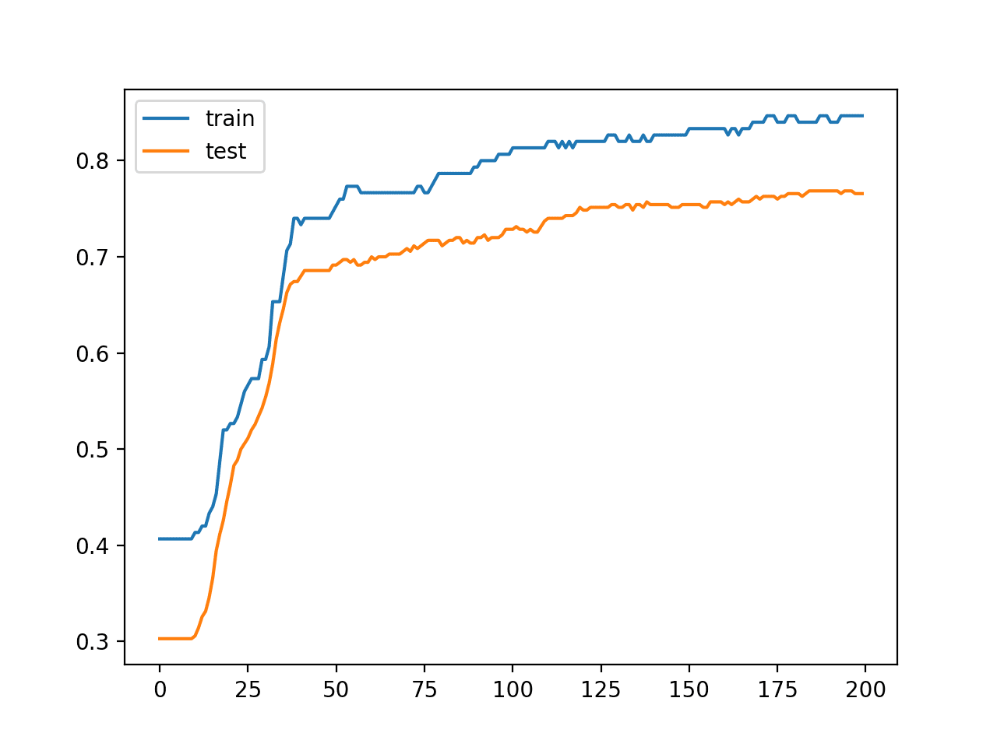
Modal accuracy before data augmentation

Slide 7
How will the hyper parameter tuning affect the model performance?
Reference to the paper by Chennupati et al. (2023).
Focus on the complexity of accident severity prediction.
Use of K-nearest neighbor and Random Forest algorithms.
Creation of a web application for efficient emergency response.

Slide 8
METHODS
Developing a Binary Classifier with Densenet161 Framework
Training the Model
Iterative Training Process
Model Evaluation and Checkpointing

Slide 9
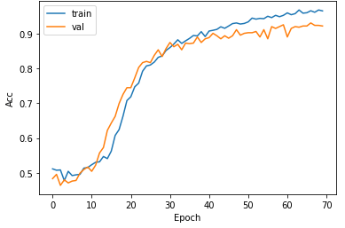
Model Accuarcy after hyper parameter tunning

Slide 10
How the proposed model is effective compared to existing work?
Reference to the paper by Gaurav et al.'s (2019)
Performance evaluation through real-world accidents, highlighting accuracy and speed advantages.
Discussion on limitations, such as the exclusion of diverse accident scenarios
Emphasis on real-time data, hardware/software technologies, and data fusion for improved accuracy.

Slide 11

METHODS
Model Analysis and Modification
Log SoftMax Function and Model Complexity
Dense Block Structure and Training Efficiency

Slide 12
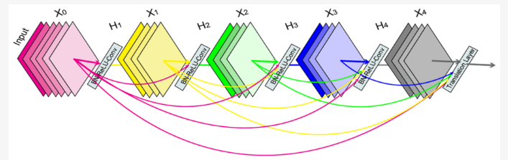
A dense block that illustrates that each layer takes all the previous feature maps as input

Slide 13
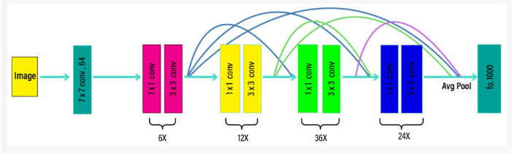
A block diagram illustrating the pretrained DenseNet-161 model.

Slide 14
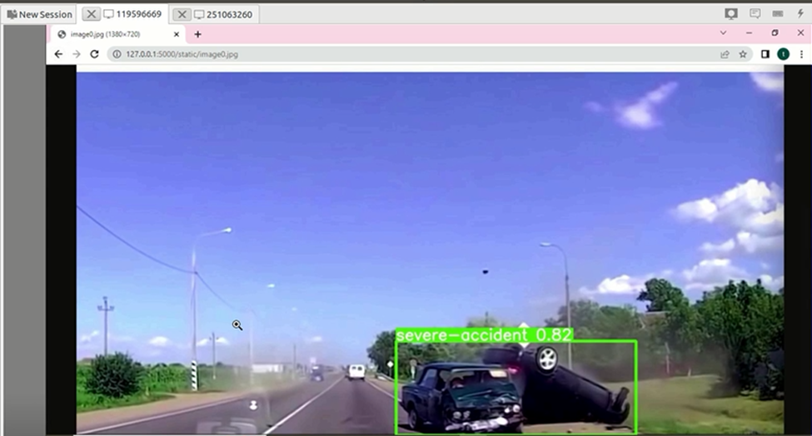
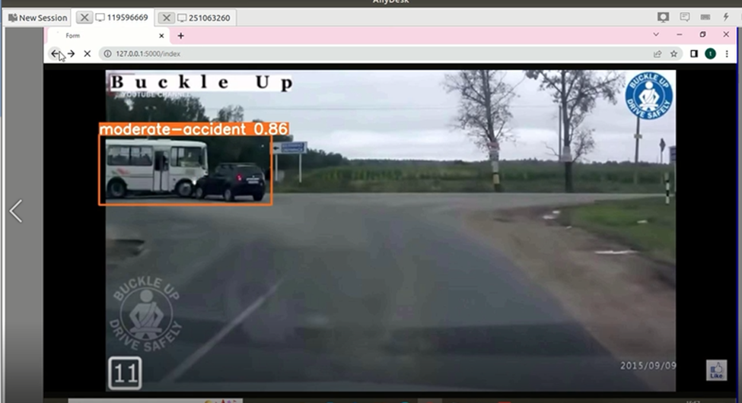
SCREENSHOTS

Slide 15
CONCLUSION
The project successfully analyzed accident severity using Densenet-161, achieving an impressive accuracy of 95%.
Several techniques were employed to enhance accuracy, starting with training the model on a pre-processed dataset to eliminate potential biases.
The accuracy improved from 90% to 95%, underscoring the importance of tuning in developing deep learning systems.

Slide 16
FUTURE STUDY
How can using newer models like densenet-201 and 169, along with deep learning techniques, improve the existing model's performance in classifying car accident images?
What research strategies should be pursued to broaden the current model beyond car accident images, and how could including additional data like weather conditions enhance the model's understanding of incident severity in future applications?

Slide 17
THANK YOU

